Slide 1













Fire Rated Door Assemblies: Compliant Designs
An AIA Continuing Education Program
Steel Door Institute
30200 Detroit Road
Westlake, Ohio 44145
www.steeldoor.org
Phone: 440-899-0010
FAX: 440-892-1404
Email: info@steeldoor.org
1
Notes:
The Steel Door Institute develops quality and performance standards for steel doors and frames. Design professionals around the world have specified SDI standards for their building projects for more than 60 years.
SDI members are the only manufacturers that are certified to meet our standards for strength, quality and consistency.
Choose quality. Specify SDI members for your steel doors and frames.

Slide 2
What is the Steel Door Institute (SDI)?
The Steel Door Institute has 11 members
Design professionals specify SDI manufacturers to ensure that their doors and frames meet the SDI standards they specify
Each member is actively involved in committees that develop codes, fire tests, and more
Standards are offered online at no charge
SDI serves as secretary to the Accredited Standards Committee (ASC) A250
Notes:
The Steel Door Institute has 11 members; the only manufacturers certified to meet SDI’s standards for strength, quality and consistency. Each member is actively involved in committees that develop codes, fire tests, and more.
Standards are offered online at no charge.
SDI serves as secretary to Accredited Standards Committee (ASC) A250.

Slide 3
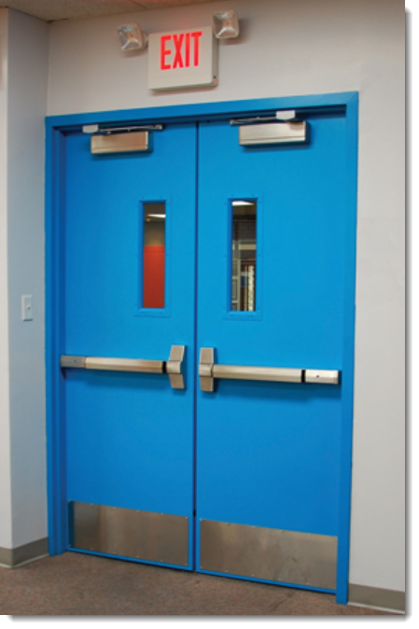
Fire Door Assemblies
Fire-resistance-rated walls with a compartmentalize a building to deter the spread of smoke and flames
Opening protectives, also known as fire door assemblies protect openings in these walls
Notes:
Walls with a fire-resistance rating compartmentalize a building to deter the spread of smoke and flames.
Fire door assemblies protect openings in these walls; fire door assemblies are also called opening protectives.

Slide 4
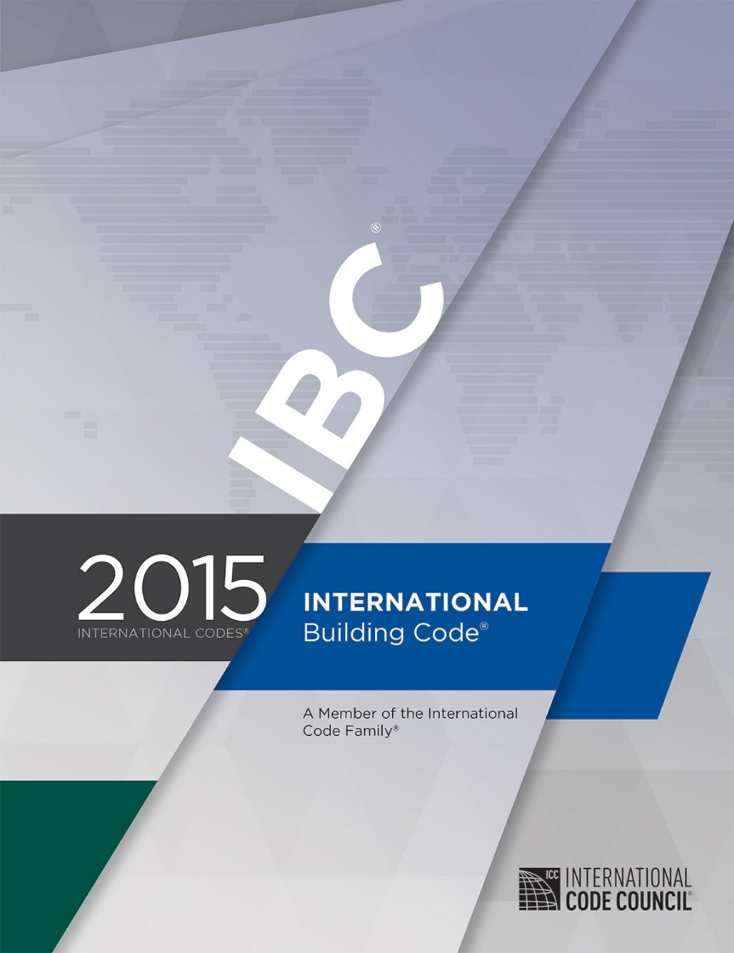
Where are Fire Door Assemblies Required?
Building code specifies where fire door assemblies are required
Most US states use the International Building Code (IBC) – many include state modifications
Requirements may vary from one edition to the next
Notes:
To determine where fire door assemblies are required, refer to the applicable building code.
The majority of US states use the International Building Code (IBC), but there may be state modifications that revise these requirements.
It’s important to know which edition of a code has been adopted in a project’s jurisdiction, as the requirements may vary from one edition to the next.

Slide 5
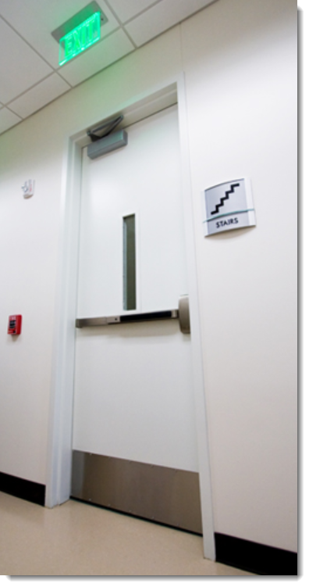
Common Locations: Stairwells
Stairwell doors are typically fire door assemblies
Stairwell door protects the stair enclosure as a means of egress
450-degree temperature rise fire doors may be required for some stairwells – typically in non-sprinklered buildings
Heat transfer is reduced for safe evacuation
Notes:
Most stairwell doors are required to be fire door assemblies.
A rated stairwell door will protect the stair enclosure to provide a safe means of egress out of the building.
Fire door assemblies with a temperature rise rating are required for some stairwells; the IBC requires stair doors in non-sprinklered buildings to be temperature-rise doors rated for 450 degrees above ambient during a 30-minute period.
Temperature rise doors reduce the heat transfer through the door so building occupants can safely pass by the door as they evacuate during a fire.

Slide 6
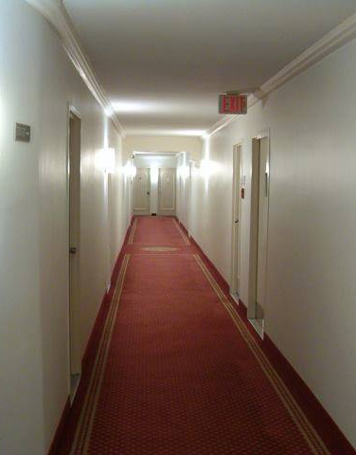
Common Locations: Residential Corridors
Dwelling units in a Residential occupancy (apartment building, hotel, or dormitory) usually have fire-rated entry doors
Helps to prevent fire from spreading beyond the unit where it began
Also protects corridor means of egress
Notes:
In a Residential occupancy like an apartment building, hotel, or dormitory, the door between each dwelling unit and the corridor is typically a fire door assembly.
This door will help to prevent the fire from leaving the unit of fire origin and spreading to other dwelling units.
The fire door assembly also protects the corridor as a means of egress for building occupants.

Slide 7
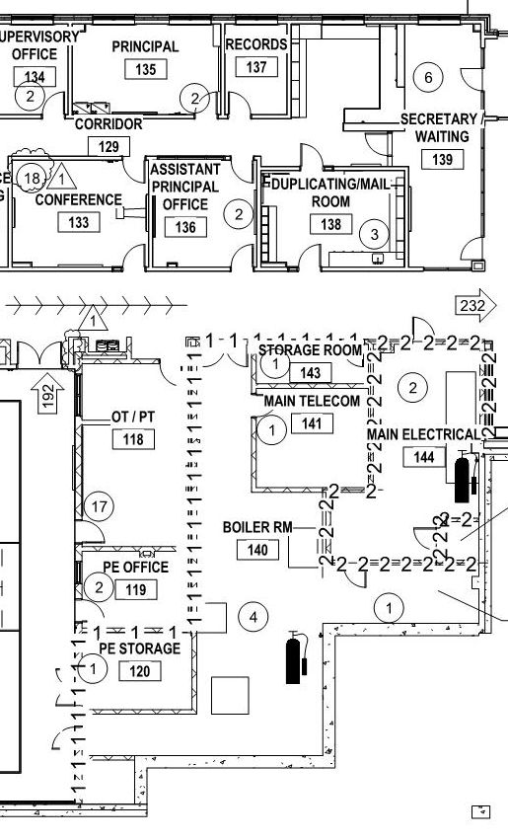
Common Locations: Incidental Use Areas
Rooms with a higher risk of fire are sometimes required to have fire-resistance-rated walls and fire door assemblies
Incidental use areas may include certain electrical rooms, furnace rooms, boiler rooms, refrigerant machinery rooms, incinerator rooms, paint shops, laboratories, and large laundry rooms
The building code specifies which rooms require fire door assemblies
Notes:
Some rooms have a higher risk of fire, and these incidental use areas are sometimes required to have fire-resistance-rated walls and fire door assemblies.
These areas may include certain electrical rooms, furnace rooms, boiler rooms, refrigerant machinery rooms, incinerator rooms, paint shops, laboratories, and large laundry rooms.
Consult the applicable code requirements to determine which rooms require fire door assemblies.

Slide 8
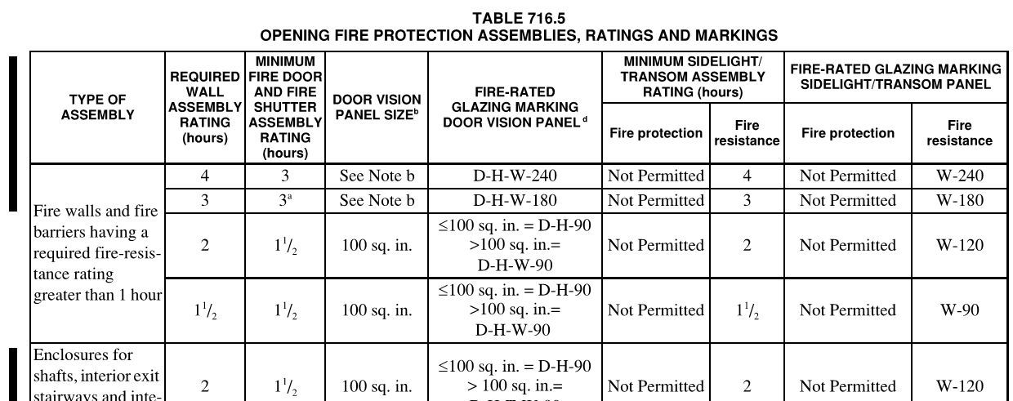
Opening Protectives
Adopted building code defines required fire-resistance rating of the wall and for the opening protective
See Table 716.5 from the 2015 IBC
Notes:
The adopted building code in a project’s jurisdiction will define the required fire-resistance rating of the wall, and the required rating for the opening protective.
For example, Table 716.5 from the 2015 IBC shows this information:

Slide 9
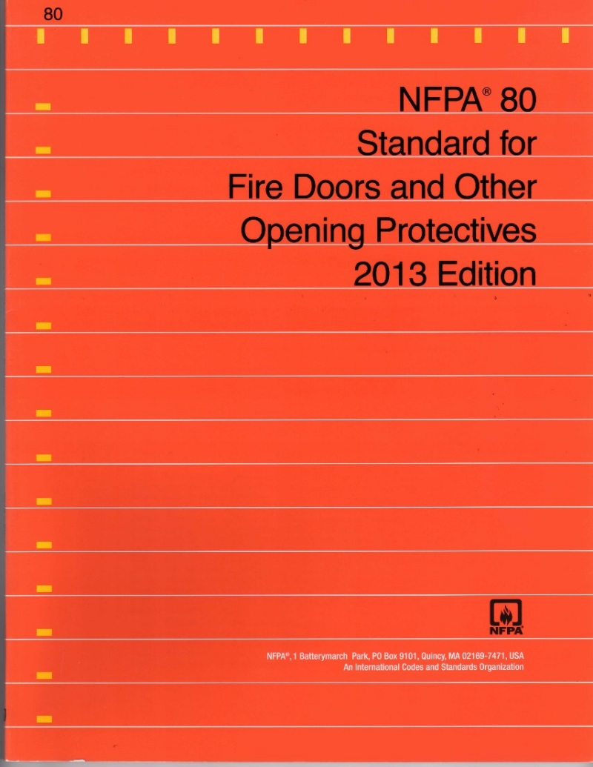
NFPA 80 – Standard for Fire Doors and Other Opening Protectives
Standard for fire doors - referenced by the International Building Code (IBC), the International Fire Code (IFC), NFPA 101 – The Life Safety Code, and other model codes
Details requirements for fire doors – more specific than model codes
Notes:
NFPA 80 is the standard for fire doors, which is referenced by the International Building Code (IBC), the International Fire Code (IFC), NFPA 101 – The Life Safety Code, and other model codes.
This document details more specific requirements for fire doors than what is included in the model codes.

Slide 10
NFPA 80 – Standard for Fire Doors and Other Opening Protectives
NFPA 80 addresses various types of opening protectives. Chapter 6 covers fire door assemblies typically found in today’s buildings.
  Chapter 1 – Administration
  Chapter 2 – Referenced Publications
  Chapter 3 – Definitions
  Chapter 4 – General Requirements
  Chapter 5 – Care and Maintenance
  Chapter 6 – Swinging Doors with Builders Hardware
  Chapter 7 – Swinging Doors with Fire Door Hardware
  Chapters 8-20 – Other Types of Doors, Glass Block, Dampers, Curtains
  Annexes

Slide 11
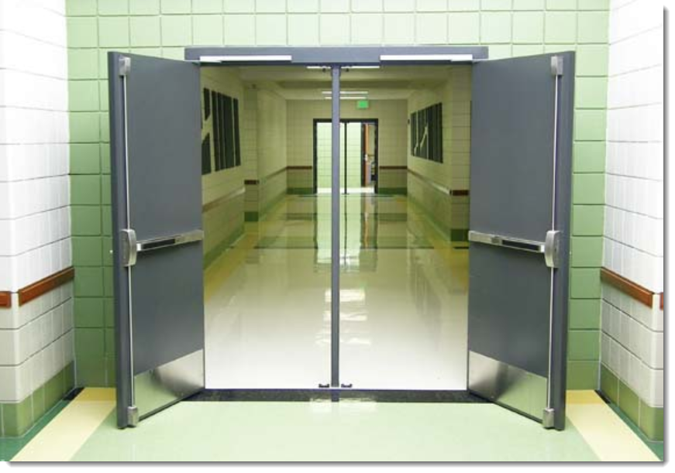
Chapter 6 - Swinging Doors with Builders Hardware

Slide 12
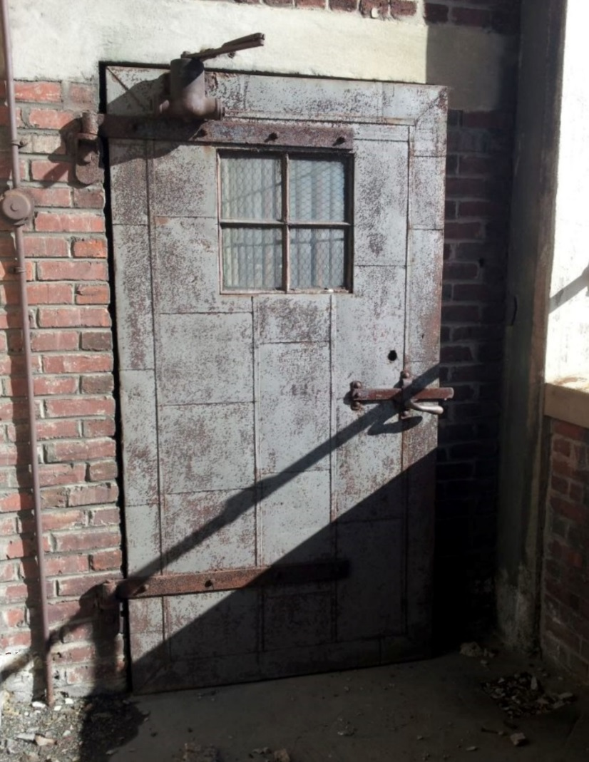
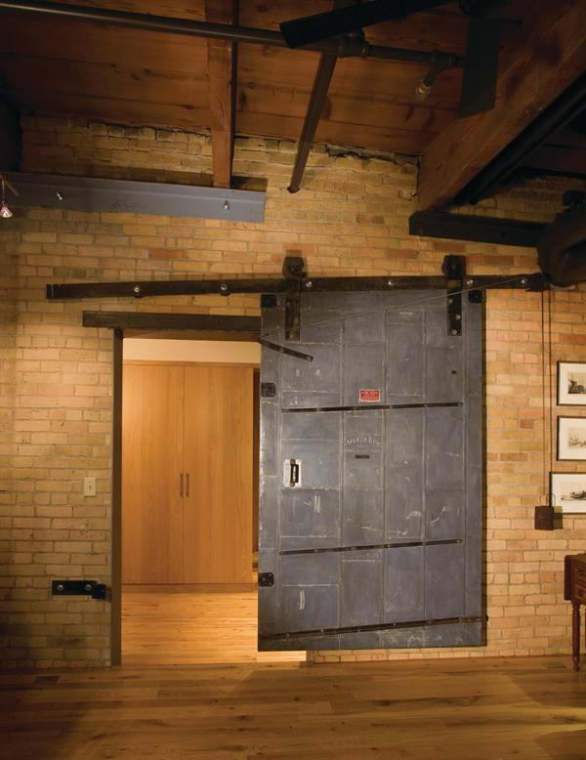
Chapter 7 - Swinging and Sliding Doors
with Fire Door Hardware

Slide 13
Classification of Openings
NFPA 80 classifies the types of openings protected by fire doors using a letter designation:
  Class A—Openings in fire walls and in walls that divide a single building into fire areas
  Class B—Openings in enclosures of vertical communications through buildings and in 2-hour rated partitions providing horizontal fire separations
  Class C —Openings in walls or partitions between rooms and corridors having a fire resistance rating of 1 hour or less
  Class D—Openings in exterior walls subject to severe fire exposure from outside the building
  Class E—Openings in exterior walls subject to moderate or light fire exposure from outside the building

Slide 14
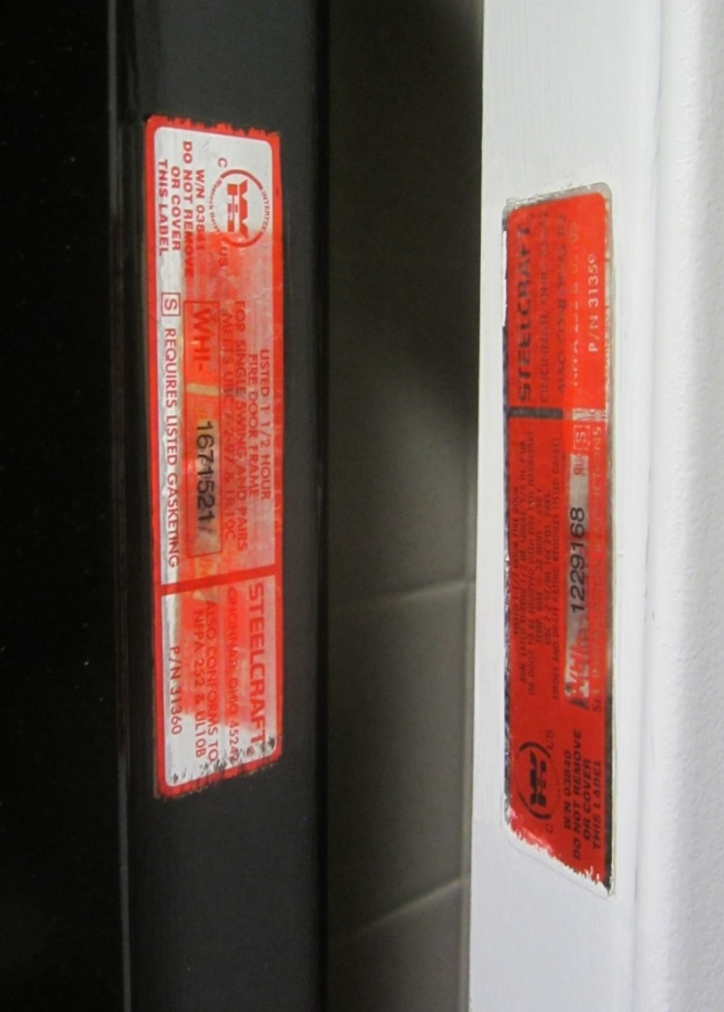
Classification of Openings
Fire door assemblies – also classified by the number of minutes they have been tested to withstand fire:
  180 minutes
  90 minutes
  60 minutes
  45 minutes
  20 minutes
B-label door used in a stair enclosure may either be classified for 60 minutes or 90 minutes
Rating is shown on the label
Notes:
Fire door assemblies are also classified by the number of minutes they have been tested to withstand fire:
180 minutes
90 minutes
60 minutes
45 minutes
20 minutes
For example, a B-label door used in a stair enclosure may either be classified for 60 minutes or 90 minutes.
This rating is shown on the label.

Slide 15
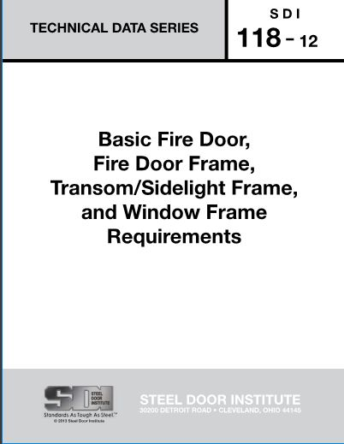
SDI 118
SDI 118, a publication of the Steel Door Institute, covers basic fire door assembly requirements
A graphical representation of the NFPA 80 opening protective requirements is also included
(see next slide)
Notes:
This publication of the Steel Door Institute covers basic fire door assembly requirements
The document also includes a graphical representation of the NFPA 80 requirements for opening protectives (next slide).

Slide 16
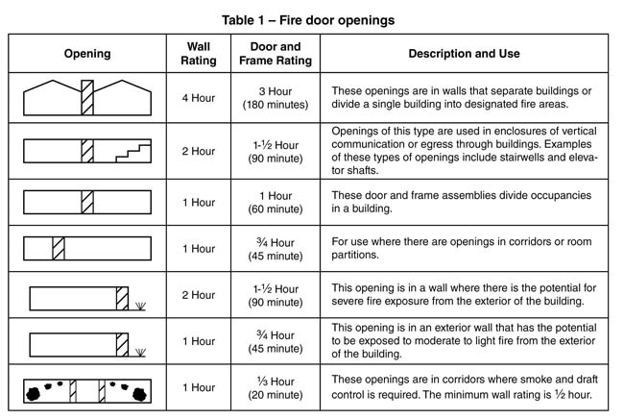

Slide 17
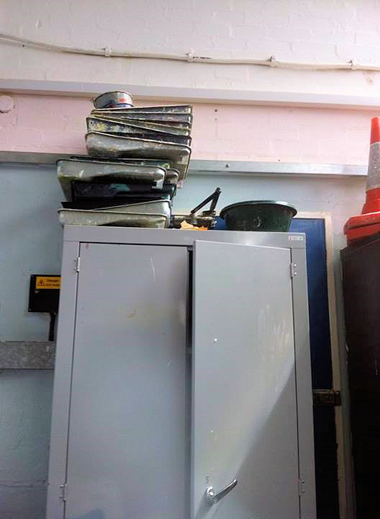
Classification of Openings
The fuel load adjacent to a door is typically lower than the fuel load against a wall, so the rating of a fire door assembly is usually lower than the rating of the wall
Fire doors that are no longer used should be replaced with construction equivalent to the wall rating
The photo illustrates a cabinet that has been placed in front of an unused door, increasing the fuel load
Notes:
The rating of a fire door assembly is often lower than the rating of the wall because the fuel load against a wall would typically be higher than the fuel load near an operable door, due to furniture or stored items.
If a fire door is no longer used and it is not required for egress, the opening protective should be replaced with construction equivalent to the rating of the wall to avoid the situation illustrated in this photo – a higher fuel load placed in front of a door.

Slide 18


Components
Components used as part of a fire door assembly must be listed for that purpose
Components may be from different manufacturers and different listing laboratories

Slide 19
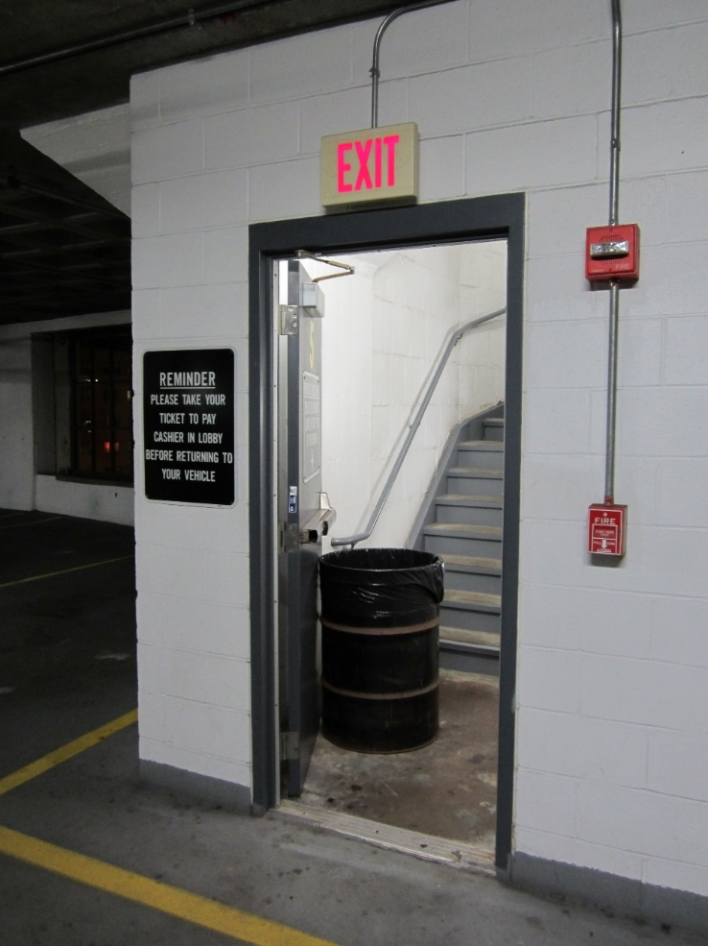
Performance
Fire door must be closed and latched at the time of a fire to provide protection
During a fire, smoke would enter the stair through this open door
Notes:
In order to perform as designed and tested, a fire door must be closed and latched at the time of a fire.
This propped-open door in a parking garage stairwell would allow smoke to spread into the stair, compromising the egress route.

Slide 20
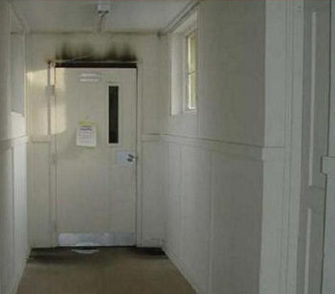
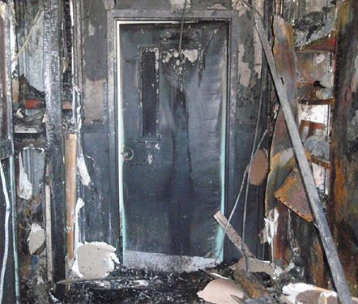
A closed fire door protected the Robert Moses Nature Center during a fire that started in the workshop
Photos courtesy of
Fire Protection Specialist Christopher Taylor
NYS Office of Fire Prevention and Control
Notes:
The Robert Moses Nature Center was protected by this fire door, which was closed and latched when a fire broke out in the workshop.

Slide 21
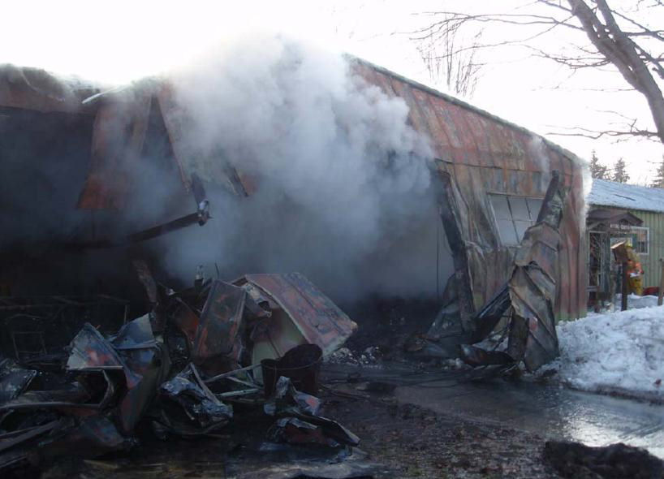
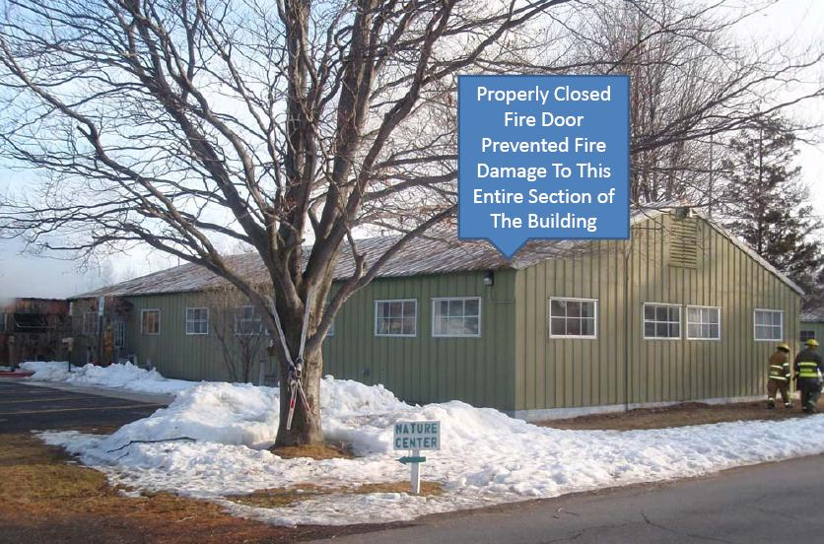
Photos courtesy of
Fire Protection Specialist Christopher Taylor
NYS Office of Fire Prevention and Control
Notes:
From these photos taken after the fire, you can see the portion of the building that was protected, and the workshop area that was destroyed.

Slide 22
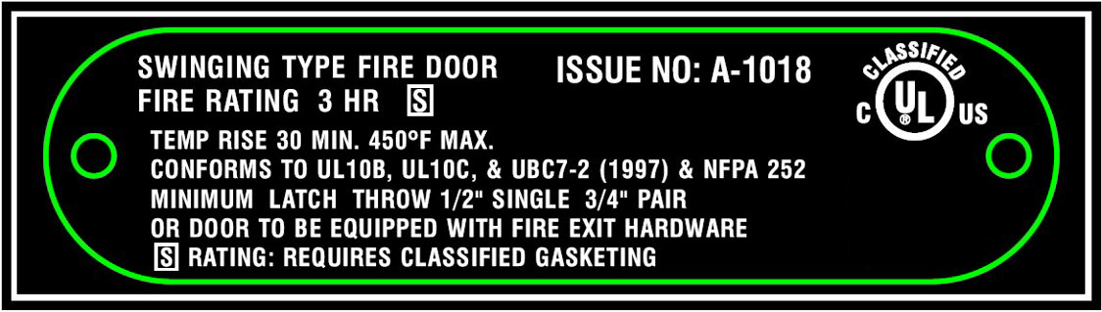
Labels
Labels must remain visible and legible
Include detailed information such as the rating, test methods, required latch throw, smoke resistance, and an issue number
Issue number can be used for further information
Notes:
Fire door labels must remain visible and legible, and will include detailed information about the fire door including the rating, test methods used, required latch throw, smoke resistance, and an issue number for that door.
The issue number can be used to research even more specific information about the door.

Slide 23
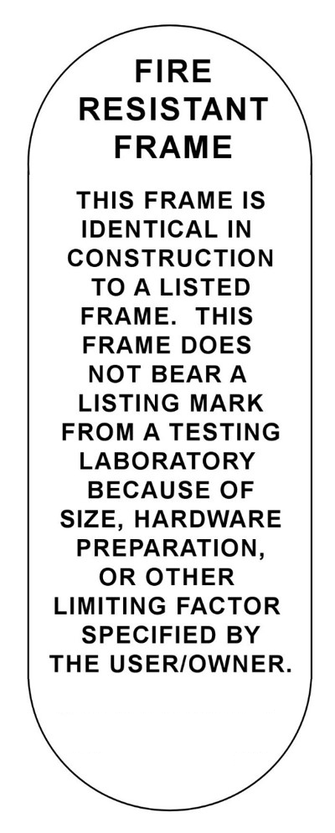
Construction Labels
Sometimes used when design calls for a door or frame that has not been tested
Label states door or frame is constructed of the same materials and methods as a listed product
Commonly used for oversized doors and frames
Authority Having Jurisdiction (AHJ) must approve the use of construction labels
Notes:
A construction label is sometimes used when the design calls for a door or frame that has not been tested in that configuration.
The label indicates that the component is of the same construction and materials as the tested and listed product.
A common application would be a fire door that is larger than the maximum size tested.
Components with construction labels must be approved by the Authority Having Jurisdiction (AHJ).

Slide 24
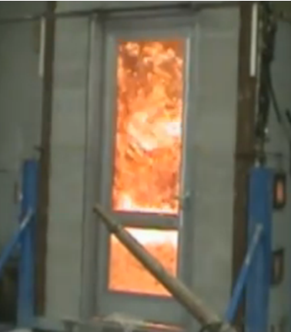
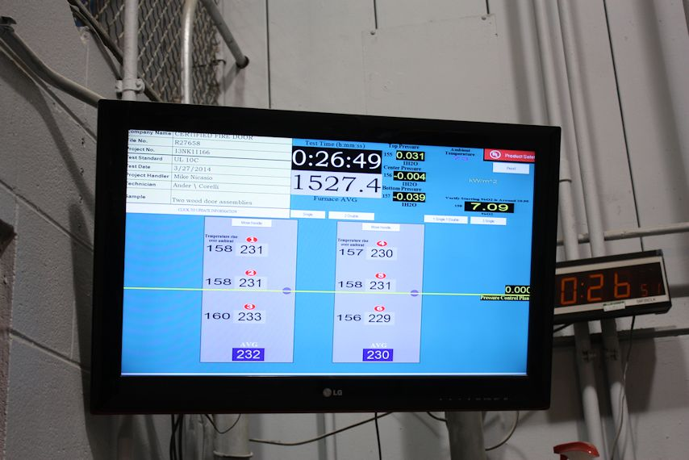
Testing
Fire door test furnace replicates effects of a fire.
Notes:
Fire door assemblies are tested in a furnace which replicates the effects of a fire.

Slide 25
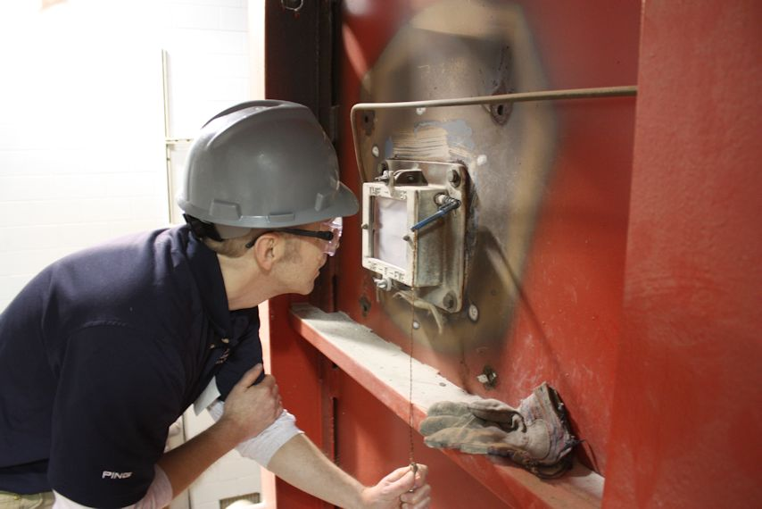
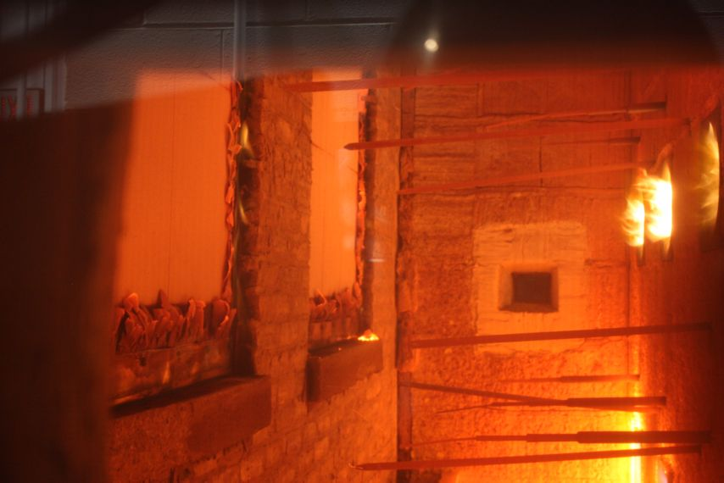
Testing
IBC - opening protectives tested to UL 10C or NFPA 252 with the neutral pressure plane at 40 inches above the floor after 5 minutes – positive pressure test method
Positive pressure testing more accurately replicates an actual fire than previous test methods
Photos courtesy of Leslie Miller
Fire Protection Publications
Notes:
The IBC requires opening protectives to be tested to UL 10C or NFPA 252 with the neutral pressure plane at 40 inches above the floor after 5 minutes.
These are positive pressure test methods.
The positive pressure testing used today more accurately replicates an actual fire than the test methods that were previously used.

Slide 26
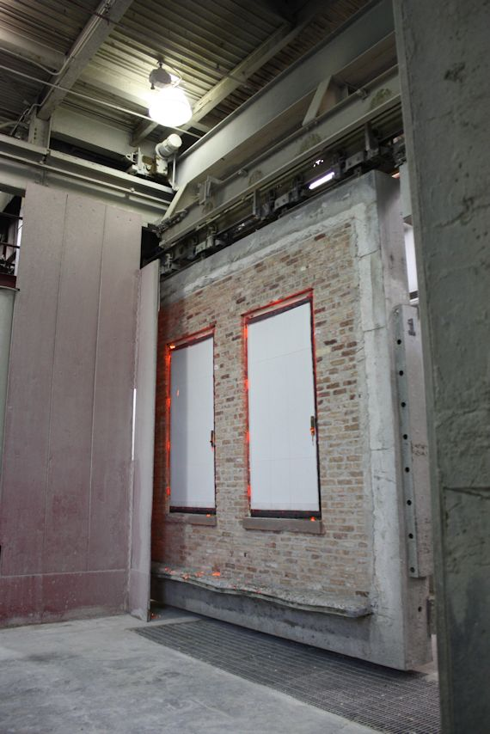
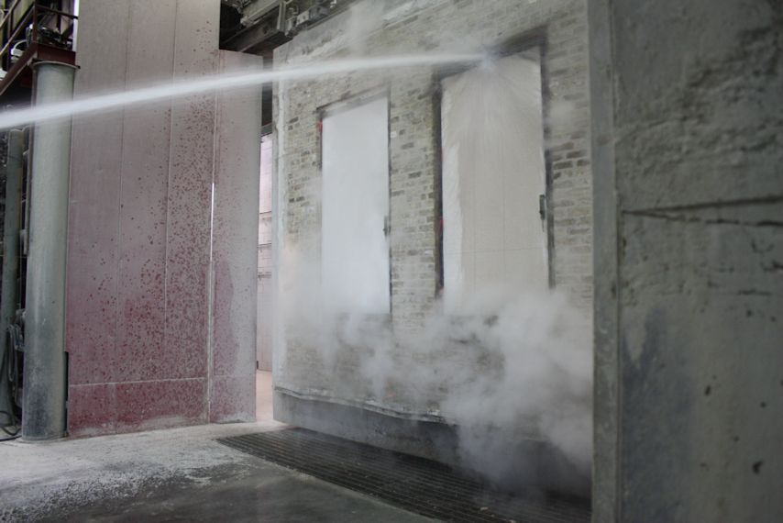
Testing
Hose stream test occurs after fire test
Not typically required for 20-minute doors in the US
Photos courtesy of Leslie Miller
Fire Protection Publications
Notes:
When the assembly is removed from the furnace, it must withstand the hose stream test.
US model codes do not typically require the hose stream test for 20-minute-rated fire doors.

Slide 27
Fire Protection vs. Fire Resistance
Fire-protection-rated assemblies - UL 10C or NFPA 252
Fire-resistance-rated assemblies - UL 263 or ASTM E119
Notes:
Testing per UL 10C or NFPA 252 is required for fire-protection-rated fire door assemblies.
The IBC requires some fire door assemblies to be tested per UL 263 or ASTM E119. These are tests that are used for building components such as walls, floors, and ceilings. Fire door assemblies tested this way are fire-resistance-rated assemblies.

Slide 28
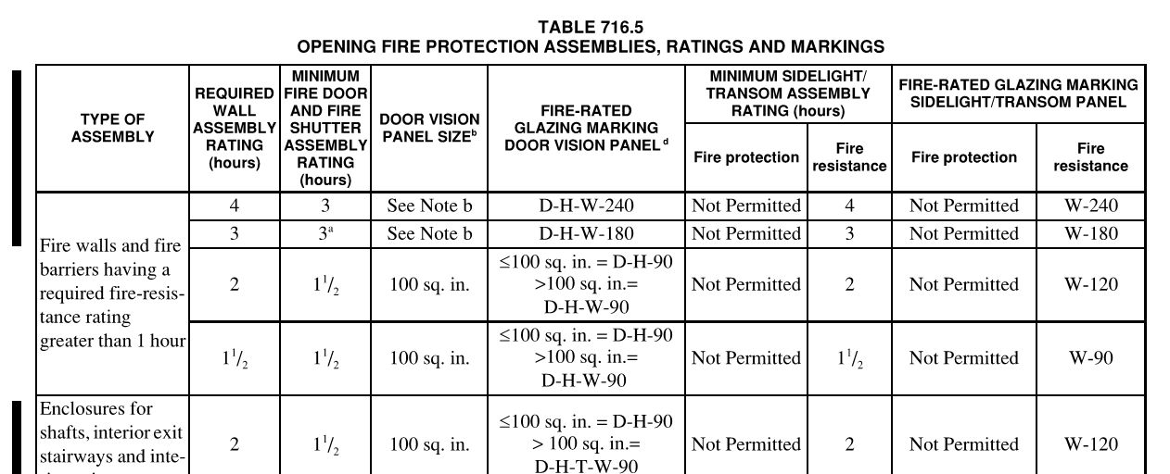
Fire Protection vs. Fire Resistance
Fire-protection-rated transom and sidelight frames are not permitted in some locations, as shown in Table 716.5 in the 2015 IBC
These locations require fire-resistance-rated frames, with a rating equal to the rating of the wall.
Notes:
Table 716.5 in the 2015 IBC shows some locations where fire-protection-rated transom and sidelight frames are not permitted.
Fire-resistance-rated frames would be required here, with a rating equal to the rating of the wall.

Slide 29
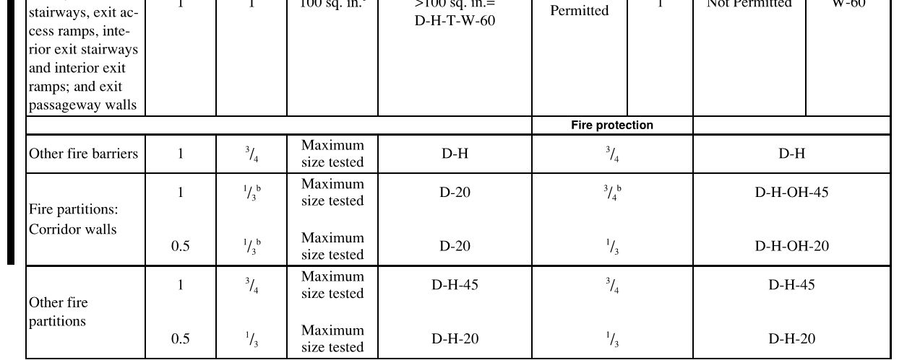
Fire Protection vs. Fire Resistance
Table 716.5 of the 2015 IBC permits fire-protection-rated assemblies in some locations
Notes:
In some walls, fire-protection-rated assemblies are permitted, as shown in this section of Table 716.5:

Slide 30
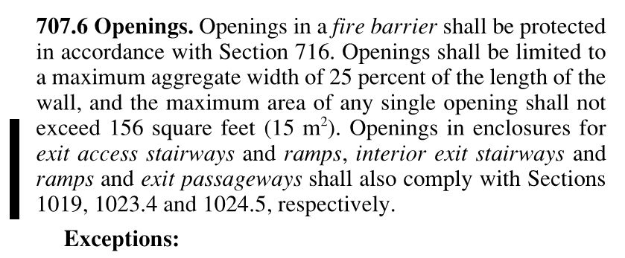
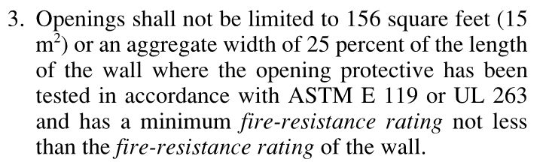
Fire Protection vs. Fire Resistance
Section 707.6 of the 2015 IBC limits openings in a fire barrier, but this limit does not apply to assemblies tested to ASTM E119 or UL 263
Notes:
Another example from the 2015 IBC is found in section 707.6, which limits the openings in a fire barrier. Per Exception 3, this limitation does not apply to assemblies tested to ASTM E119 or UL 263.

Slide 31
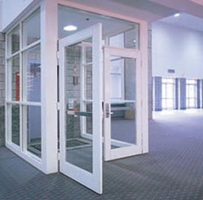
Fire Protection vs. Fire Resistance
Manufacturers have limitations on glazing in fire doors and frames
May vary by type of glazing
Fire-resistance-rated frames require fire-resistance-rated glazing
Notes:
For fire-rated frames with glazing, it’s important to note the limitations on glazing size and type, which can vary by manufacturer.
Installing fire-resistance-rated glazing in a fire-protection-rated frame does not create a fire-resistance-rated assembly.

Slide 32
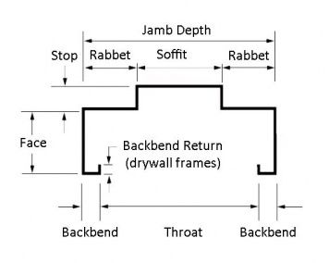
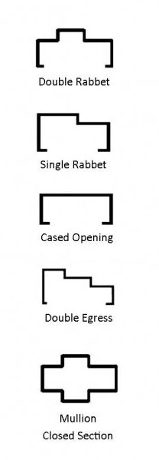
Design Considerations
Door opening sizes are limited by manufacturer’s listings and also by structural integrity and ability to function properly
Jamb depth of frame relates to wall thickness – verify availability of fire rated configuration for custom profiles
Notes:
Door opening sizes are limited by the manufacturer’s listings, but also by the door’s ability to function properly. A 20-foot-tall door may seem like a good way to make a statement, but without proper engineering it will not function well over time.
A frame’s jamb depth is typically related to the wall thickness. Some jamb depths and custom profiles may not be available for a fire-rated frame if the manufacturer has not tested that specific configuration.

Slide 33
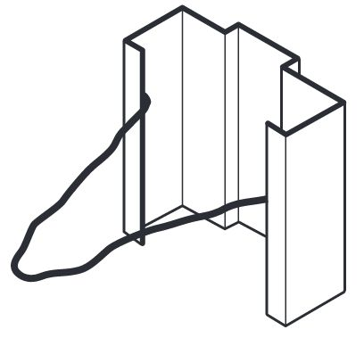
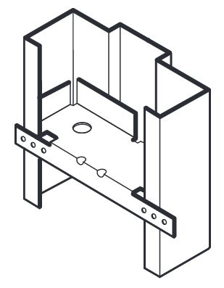
Anchors
Masonry
Wire
Anchor
Anchors and installation methods provided by the manufacturer must be used
Anchor options - stud framing, masonry, existing walls, and compression anchors for drywall frames
Base anchors may be used in lieu of an additional wall anchor
Stud
Anchor
Notes:
Fire door frames must be installed with the anchors and installation methods provided by the manufacturer.
Anchors are available for stud framing, masonry, and existing walls, as well as compression anchors for installations where the drywall is in place before the frame is installed.
Base anchors must be installed to securely anchor the frame at the bottom of the opening.

Slide 34
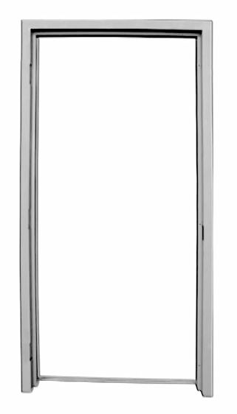
Frame Construction
3-sided frames may be supplied as welded frames or as knocked-down frames
Transom, sidelight, and borrowed light frames are typically welded units, but may be field-spliced
Notes:
Most fire-rated 3-sided frames can be supplied to the job-site as welded frames, or as knocked-down frames that need to be assembled on-site.
Transom, sidelight, and borrowed light frames are typically delivered as welded units, although some may be field-spliced if necessary.

Slide 35
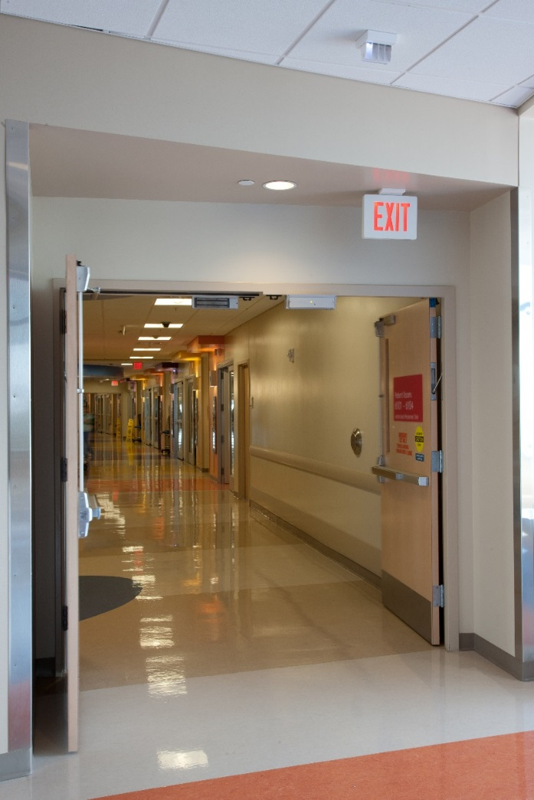
Double-Egress Pairs
Double-egress pairs have one leaf swinging in each direction for egress
Swinging the door on the right in the direction of egress helps with traffic flow
Fire exit hardware is required for fire-rated double-egress pairs, unless otherwise tested
Notes:
Pairs of doors with one leaf swinging in each direction are designed to facilitate egress from either direction in a corridor; these are called double-egress pairs.
Typically, the door on the right as you face the opening will swing in the direction of egress for optimal traffic flow.
Fire-rated double-egress pairs must be equipped with fire exit hardware unless a manufacturer has tested their products with an alternate latching method.

Slide 36
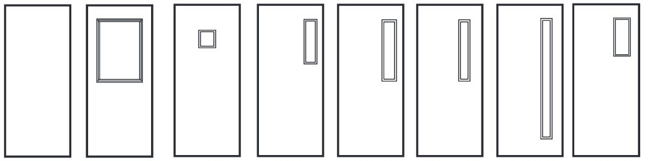
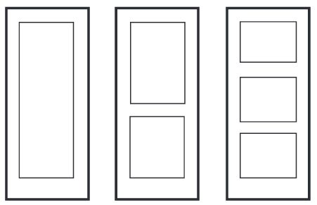
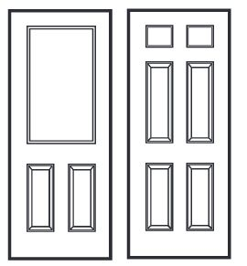
Door Elevations
Various core types, gauges, and elevations available
Watch out for light/lock cutouts
Accessibility standards require vision lights (if provided) to be mounted with the bottom at a maximum of 43 inches above the floor – lights above 66 inches are exempt
Notes:
Fire doors are available in various core types, gauges, and elevations depending on the required fire rating.
The required distance between cutouts for vision lights and hardware can vary from one manufacturer to the next; watch out for light/lock conflicts.
If a door has a vision light, current accessibility standards require the bottom of at least one light to be a maximum of 43 inches above the floor, with the exception of lights above 66 inches; these lights are intended only for light transmission.

Slide 37
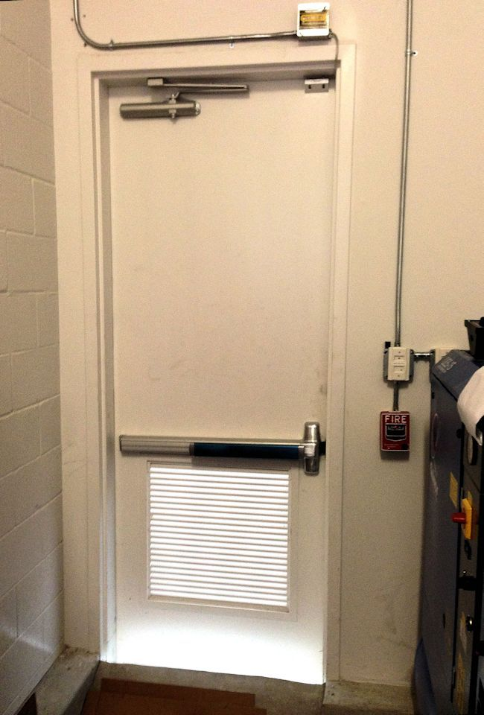
Louvers
Many automatic louvers close upon heat activation and could allow smoke to spread
IBC prohibits the use of louvers in smoke barriers, smoke partitions, or corridor smoke and draft control assemblies
Notes:
Automatic louvers are designed to close automatically if there is a fire, but many of these products are heat-activated.
Because smoke could pass through the louver before the activation temperature is reached, the IBC prohibits the use of louvers in smoke barriers, smoke partitions, or corridor smoke and draft control assemblies.

Slide 38
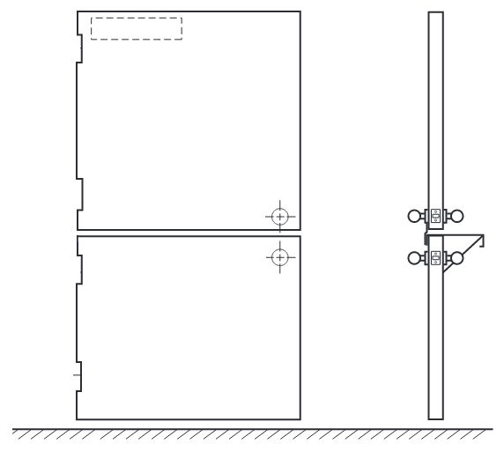
Dutch Doors
Fire-rated Dutch doors typically have:
  a door closer and electronic hold-open device on the top leaf
  an astragal between the top and bottom leaves to close bottom leaf
  an active latchbolt on each leaf
Notes:
Fire-rated dutch doors typically have a door closer and electronic hold-open device on the top leaf.
An astragal between the top and bottom leaves ensures that when the top leaf closes, the bottom leaf closes too.
Each leaf must be equipped with an active latchbolt for positive latching. If each leaf latches into the jamb, this can create an egress problem as both latches have to be retracted simultaneously for egress. Some manufacturers’ listings allow the top leaf to latch into the bottom leaf, with the bottom leaf latching into the jamb.

Slide 39
Operation of Doors
Fire doors must be either be self-closing, automatic-closing, or power-operated, with two exceptions:
  IBC - exempts communicating doors between hotel rooms from the self-closing requirement
  NFPA 80 – exception for the inactive leaf of a pair leading to a room not normally occupied by humans, if acceptable to the AHJ
Self-closing doors - door closer or other closing device - closes the door each time it is opened
Notes:
NFPA 80 requires fire doors to be self-closing, automatic-closing, or power-operated, with two exceptions:
The IBC exempts communicating doors between hotel rooms from the self-closing requirement.
NFPA 80 allows the closer to be omitted on the inactive leaf of a pair leading to a room not normally occupied by humans, if acceptable to the AHJ.
Self-closing doors have a door closer or other closing device which closes the door each time it is opened.

Slide 40
Operation of Doors
Automatic-closing doors - electronic hold-open mechanism releases and allows the door to close during a fire
  IBC requires hold-opens used in most fire door locations to be smoke-activated, not heat-activated
Power-operated doors - automatic operators must be disconnected during a fire
Notes:
Automatic-closing doors are equipped with an electronic hold-open mechanism which releases and allows the door to close during a fire. The IBC requires these devices to be smoke-activated for most fire door locations; fusible link arms are activated by heat and can not be used where smoke-actuated release is required.
Power-operated doors have automatic operators used to open the door. The operator must be automatically disconnected during a fire.

Slide 41
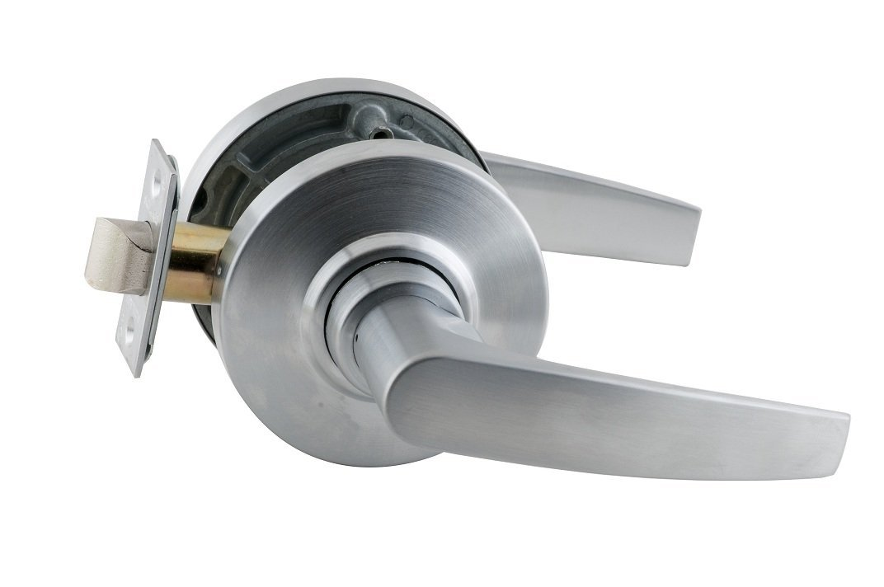
Positive Latch
Active latchbolt is required for each fire door, to keep the door latched during a fire
Ensures door is closed to protect the opening
Minimum latch throw as required by manufacturers’ listings – not specified by recent editions of NFPA 80
Notes:
Fire doors must have an active latchbolt which automatically latches the door when it closes, with a few exceptions.
This ensures that the door remains in the closed position during a fire and firefighting operations.
The minimum latch throw is no longer specified in NFPA 80 – it is dependent upon the door manufacturer’s listings.

Slide 42
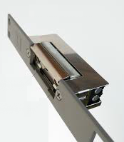
Electric Strikes
Electric strike replaces original strike and controls latchbolt of the lock or panic hardware to allow or restrict access
Electric strikes for fire door assemblies must be “fail-secure” - latchbolt is secure behind strike keeper when power is cut
Fail-safe strike could allow door to become unlatched during a fire, and is not allowed
Strike keeper should automatically be put into secure position during a fire alarm
Notes:
An electric strike is an access control product that replaces the original strike plate and controls the latchbolt of the lock or panic hardware to allow or restrict access.
Electric strikes used on fire door assemblies must be “fail-secure,” which means that the latchbolt will be secure behind the strike keeper when power is cut. A “fail-safe” electric strike could allow the door to become unlatched during a fire.
The strike keeper should automatically be put into the secure position upon activation of the fire alarm system.

Slide 43
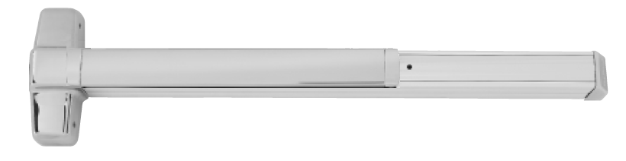
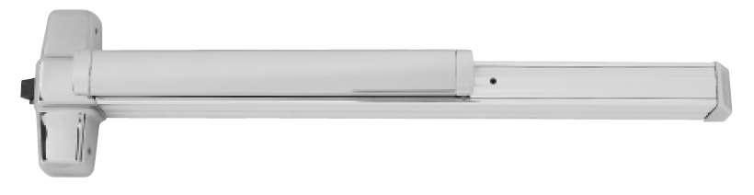
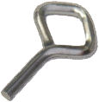
Fire Exit Hardware
Fire exit hardware - panic hardware used on fire door assemblies
No mechanical dogging on fire exit hardware
Electric latch retraction may be used – latch projects on fire alarm
Notes:
Fire exit hardware is a type of panic hardware that is used on fire door assemblies where required by egress codes.
Mechanical dogging – the ability to hold the latch retracted using a key or tool, is not an available option on fire exit hardware.
The latch may be held retracted electrically if during a fire emergency the door becomes positively latched by a device that is activated by the fire detection system. Electric latch retraction is commonly used for this application.

Slide 44
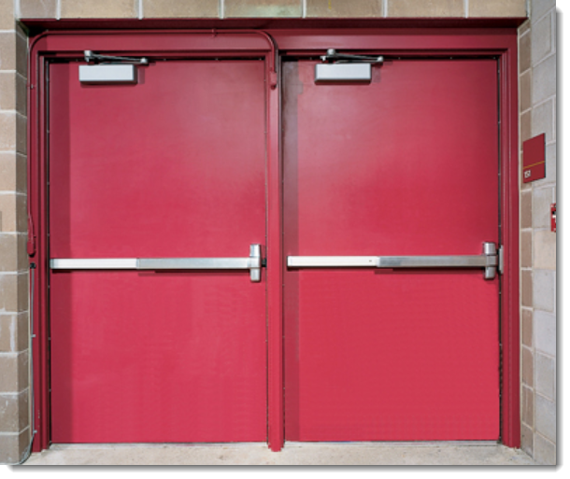
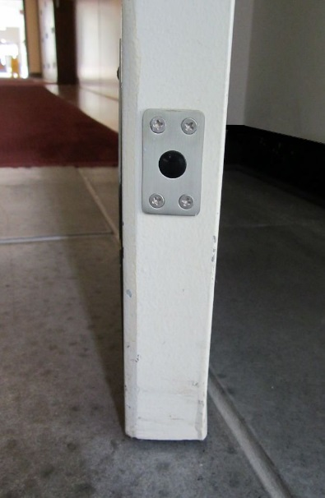
Fire Exit Hardware
Less Bottom Rod (LBR) or Less Bottom Latch (LBL) – no bottom rod, latch, or strike
Auxiliary fire pin typically required for LBR/LBL applications - mounted on the door edge - retracted until released during a fire
Notes:
Fire exit hardware is also available without the bottom latch – commonly called less bottom rod (LBR) or less bottom latch (LBL).
An auxiliary fire pin is typically required when the bottom latch is omitted. This pin is mounted on the door edge and stays retracted until it is released by the heat of a fire to project into the edge of the other door.

Slide 45

Automatic Flush Bolts
Positive latching requirement for pairs, automatic flush bolts or fire exit hardware
  Exception for manual flush bolts for rooms not normally occupied by humans, like a storage room or mechanical room, if acceptable to the AHJ
Auxiliary fire pin may be used in lieu of a bottom bolt with some automatic flush bolts
No hardware that would indicate an operable door, such as a dummy lever or push bar
Notes:
Pairs of doors may be equipped with fire exit hardware or automatic flush bolts to satisfy the requirement for an active latchbolt.
NFPA 80 includes an exception that allows manual flush bolts to be used for rooms not normally occupied by humans, like a storage room or mechanical room - if it’s acceptable to the AHJ.
An auxiliary fire pin may be used in lieu of a bottom bolt with some automatic flush bolts.
A door with automatic flush bolts can not be equipped with hardware that would indicate an operable door, for example, a dummy lever or push bar.

Slide 46
Automatic Flush Bolts and Coordinators
Automatic flush bolts are projected by the active door leaf
Coordinator required for doors with automatic flush bolts – inactive leaf must close first
Bar-type coordinator (below) mounts on the underside of the frame head; gravity coordinator (right) mounts on face of frame head
Notes:
Automatic flush bolts are projected by the active door leaf when it closes and actuates the trigger mechanism on the bolt.
A coordinator is required for doors with automatic flush bolts to ensure that the doors close in the correct sequence. The inactive leaf must be closed before the active leaf closes.
A bar-type coordinator (below) mounts on the underside of the frame head. Gravity coordinators (right), which are less commonly used, mount on the face of the frame head.

Slide 47


Astragals
Overlapping astragal not mandatory for every fire door
May be required by manufacturer’s listings
Projection of approximately ¾ inch when astragal is required
Astragal must not restrict egress
Coordinator may be required
Overlapping Astragal
Split Astragal
Meeting Stile Gasketing
Notes:
An overlapping astragal is not mandatory for every fire door, but may be a requirement of the door manufacturer’s listings.
If an astragal is required, NFPA 80 specifies a projection of approximately ¾ inch.
The astragal is not allowed to restrict egress by preventing one leaf of the pair from being opened.
A coordinator is sometimes required when an overlapping astragal is used.

Slide 48

Hinges
Steel base material, ball bearing type, or listed for use on a fire door
2 hinges for the first 60 inches of door height, 1 additional hinge for each additional 30 inches of door height, or portion thereof
Spring hinges - doors maximum of 3 feet wide and 7 feet high, or as tested
NFPA 80-2013 - length of continuous hinges must be within 1 inch of the door height
Notes:
Hinges for fire doors must have a steel base material and be of the ball bearing type, or must be listed for use on a fire door.
2 hinges are required for the first 60 inches of door height, with 1 additional hinge for each additional 30 inches of door height, or portion thereof.
Spring hinges are limited by NFPA 80 to doors that are a maximum of 3 feet wide and 7 feet high, or as tested.
NFPA 80-2013 requires the length of continuous hinges to be within 1 inch of the door height.

Slide 49
Pivots
New in the 2013 edition:
With top and bottom pivots:
  1 intermediate pivot for doors up to 90 inches in height
  For doors over 90 inches in height, 1 additional intermediate pivot for each 30 inches of door height or fraction thereof
With only intermediate pivots - no top and bottom pivot set:
    2 intermediate pivots for door leaves up to 60 inches in height
    1 additional intermediate pivot for each 30 inches of door height or fraction thereof
Notes:
The 2013 edition of NFPA 80 includes new requirements for pivots on fire doors.
If top and bottom pivots are used:
1 intermediate pivot is required for doors up to 90 inches in height.
For doors over 90 inches in height, 1 additional intermediate pivot is required for each 30 inches of door height or fraction thereof.
If only intermediate pivots are used (no top and bottom pivot set):
2 intermediate pivots are required for door leaves up to 60 inches in height
1 additional intermediate pivot is required for each 30 inches of door height or fraction thereof.

Slide 50


Fasteners
Install hardware with fasteners supplied by manufacturer, unless alternative fasteners are allowed
Thru-bolts may be required unless doors have special internal reinforcement or blocking
Specific requirements for fasteners for some products in NFPA 80
Notes:
Hardware on fire doors must be installed with fasteners supplied by the hardware manufacturer unless alternative fasteners are allowed by the manufacturer’s listing procedures.
Some products are required to be thru-bolted.
Special blocking is available for some fire doors if thru-bolts are not desired.
NFPA 80 includes specific requirements for attaching some types of hardware, including hinges and locks.

Slide 51

Clearance and Undercut
Clearance limited by NFPA 80:
  Bottom of door, 3/4 inch maximum, 3/8 inch maximum if bottom of door is more than 38 inches above the floor (ie. counter shutter, chute door)
  Hollow Metal Door - head, jambs, and meeting stiles: 1/8 inch +/- 1/16 inch
  Wood Door - head, jambs, and meeting stiles of wood doors 1/8 inch, max
Notes:
Clearance around a fire door is limited by NFPA 80.
At the bottom of the door, 3/4 inch maximum is allowed, or 3/8 inch if the bottom of the door is more than 38 inches above the floor (for example, a counter shutter or chute door).
At the head, jambs, and meeting stiles, the clearance for hollow metal doors is limited to 1/8 inch +/- 1/16 inch.
The clearance at the head, jambs, and meeting stiles of wood doors is limited to 1/8 inch.

Slide 52

Notes:
This meeting stile clearance is in excess of what is allowed by NFPA 80.

Slide 53

Clearances and Undercuts
Doors with non-compliant clearances can not be repaired by adding standard gasketing products
Product must be specifically listed for use on a door with oversized clearances
Note limitations on fire rating, door material, and clearance dimension.
Notes:
Standard gasketing products, even if listed for use on a fire door assembly, can not bring a door with non-compliant clearances into compliance.
Products have been developed and tested which can be used to address oversized clearances subject to the stated limitations of their listings.

Slide 54

Gasketing
Smoke and draft control doors must be tested for air infiltration in accordance with UL 1784
Maximum air leakage rate limited by the IBC to 3.0 ft³/min/ft² of door opening
Gasketing required to limit air infiltration to this level
Gasketing and threshold products must be listed for use on a fire door assembly
Bottom seals and thresholds are not required for fire doors in many locations, pressurized stairs may benefit from gasketing
Notes:
Some fire doors and smoke doors are considered “smoke and draft control doors”, and must be tested for air infiltration in accordance with UL 1784.
The maximum air leakage rate of the door assembly is limited by the IBC to 3.0 ft³/min/ft² of door opening measured at several temperatures.
Gasketing is typically required in order to limit air infiltration to this level.
All gasketing and threshold products used on fire door assemblies must be listed for use on a fire door.
Bottom seals and thresholds are not required for fire doors in most locations, although pressurized stairs may benefit from this seal.

Slide 55

Terminated Stops
Terminated stops are also called ‘sanitary stops’ or ‘hospital stops’
Purpose - reduce the number of corners for debris to accumulate
Often used in health care facilities
Not currently addressed in NFPA 80, but most manufacturers’ listings allow 6” terminated stops on fire door assemblies
UL 1784 does not measure air infiltration through the bottom 6 inches of the opening
Notes:
Terminated stops on frames are also called sanitary stops or hospital stops. Their purpose is to reduce the number of corners for debris to accumulate around the frame stop at floor level, particularly in health care facilities.
Although terminated stops are not currently addressed in NFPA 80, most manufacturers’ listings allow stops to terminate at a maximum of 6” above the floor.
Smoke infiltration is not an issue in this area of the door because of the UL 1784 test protocol which does not measure air infiltration through the bottom 6 inches of the opening.

Slide 56

Protection Plates
NFPA 80 limits the height of protection plates on fire doors:
  Bottom 16 inches of the door - may be field-installed, no label required on plate
  Installed under label service (at the factory or in an approved shop) – as allowed by the manufacturer’s listings
  Field-installed plates mounted above the bottom 16 inches of the door – must be labeled
Notes:
NFPA 80 limits the height of protection plates on fire doors.
Plates installed in the bottom 16 inches of the door may be field-installed and are not required to be labeled.
Plates installed under label service - installed at the factory or in an approved shop – can be of any size allowed by the manufacturer’s listings.
Labeled plates have a label indicating that they can be used on fire doors, and these may be installed in the field.

Slide 57


Plant-Ons
Plant-On: decorative trim applied to the face of a door
Consult door manufacturer to verify listing requirements before installing plant-ons
Notes:
Decorative trim applied to the face of a door is called a plant-on.
The door manufacturer must be consulted to verify their listing requirements before plant-ons are installed.

Slide 58

Glazing
NFPA 80 - general limitations on the size and type of glazing allowed
Limited to the maximum area tested by the door or frame manufacturer, and the glazing manufacturer
Each piece of glazing must have a label or etching
Notes:
NFPA 80 includes some general limitations on the size and type of glazing allowed in fire door assemblies.
Glazing is limited to the maximum area tested by the door or frame manufacturer, and the glazing manufacturer.
Each piece of glazing must have a label that indicates fire protection capabilities.

Slide 59

Glazing
IBC requires glazing in doors, sidelights, and other hazardous areas to be impact-resistant
Glazing in fire doors was exempt from the impact requirements until the 2003 edition of the IBC
More than 2,000 accidents from non-impact-resistant traditional wired glass are reported in schools each year
Impact-resistant wired glass is available; each piece marked to indicate compliance
Notes:
Glazing in doors, sidelights, and other hazardous areas is now required by the IBC to be impact-resistant.
Prior to the 2003 edition of the IBC, glazing in fire doors was exempt from the requirements for impact protection. That exception has since been removed from the IBC.
Traditional wired glass is not impact-resistant, and there are more than 2,000 accidents due to this glass in US schools each year.
Impact-resistant wired glass is now available, and each piece is marked to indicate compliance.

Slide 60

Signage
Does not exceed 5% of the door face
Must not impair door operation
No signage on glass or glazing
Attached with adhesive, never with mechanical attachments such as screws or nails
Sign at right is non-compliant – installed with screws
Notes:
NFPA 80 limits signage on a fire door to informational signs which do not exceed 5 percent of the area of the face of the door.
Signs must be attached with adhesive, and must not impair or interfere with the proper operation of the door.
Mechanical attachments (screws/nails) are not permitted.
Signs must not be installed on glass / glazing material in fire doors.
The sign pictured here is non-compliant because it is attached with screws.

Slide 61

Job-Site Preparations / Field Modifications
Job-site preparations:
  Holes for hardware up to 1 inch in diameter
  Cylinder holes may be of any size
  Maximum 3/4 inch undercutting if acceptable to the door manufacturer.
  Field modifications beyond the allowable job-site modifications; advance approval needed from listing laboratory
  Assembly may need to be relabeled in the field if other alterations are made
Notes:
Fire door assemblies can be altered in the field, but NFPA 80 restricts these alterations. Job-site preparations for hardware may include holes up to 1 inch in diameter (cylinder holes may be of any size), and a maximum 3/4 inch undercutting if acceptable to the door manufacturer.
Field modifications for alterations that are not allowed as job-site preparations may be approved by the listing laboratory if a description of the modification is submitted in advance.
Other alterations may require the assembly to be relabeled by the listing lab in the field.

Slide 62

Job-Site Preparations / Field Modifications
When material is removed from a fire door or frame, the holes must be:
  filled with steel fasteners
  filled with the same material as the door or frame, or
  filled with a material approved for that use
Intended to apply to fastener holes
Consult the door or frame manufacturer for holes that are not fastener holes
Notes:
When material is removed from a fire door or frame, the holes must be filled with steel fasteners, or the same material as the door or frame, or a material approved for that use.
This NFPA 80 requirement is intended to apply to fastener holes.
For larger holes left by hardware that has been removed, the door or frame manufacturer should be consulted to determine what will meet their listing procedures.

Slide 63

Fire Door Assembly Inspection
Past codes required fire doors to be kept code-compliant condition
Many existing assemblies are deficient
Annual inspection required added to the 2007 edition of NFPA 80
2013 edition requires fire doors to be inspected by a Qualified Person after installation and after maintenance work, in addition to annually.
Inspections are required when a fire code references the 2007 edition or a subsequent edition of NFPA 80
Notes:
Fire doors have been required by past codes to be kept in code-compliant condition, but many existing assemblies are deficient.
A requirement for the annual inspection of fire door assemblies was added to the 2007 edition of NFPA 80, to improve the condition of existing fire doors.
The 2010 edition defines a Qualified Person as: “A person who, by possession of a recognized degree, certificate, professional standing, or skill, and who, by knowledge, training, and experience, has demonstrated the ability to deal with the subject matter, the work, or the project.”
The 2013 edition requires fire doors to be inspected by a Qualified Person after installation and after maintenance work, in addition to annually.
If a fire code references the 2007 edition or a subsequent edition of NFPA 80 for maintenance of fire doors, inspections are required in accordance with NFPA 80’s care and maintenance requirements.

Slide 64
Fire Door Assembly Inspection
Responsibility of the building owner or property manager
Documentation is reviewed by the AHJ
Functional testing ensures door will be closed and latched during a fire
Operational testing of automatic-closing doors
Deficiencies noted must be repaired “without delay”
2007 and 2010 editions of NFPA 80 - 11 inspection criteria; 2013 edition - 13 inspection criteria
(continued on next slide)
Notes:
Inspections are the responsibility of the building owner or property manager; documentation of the inspection is then kept for review by the AHJ.
Both sides of the door are visually inspected.
Functional testing is conducted to ensure door leaves will be closed and latched under fire conditions.
Inspections include operational testing of automatic-closing doors.
Deficiencies noted must be repaired “without delay.”
The 2007 and 2010 editions of NFPA 80 include 11 inspection criteria; the 2013 edition includes 13 inspection criteria:
(next slide)

Slide 65
Fire Door Assembly Inspection
Label visible and legible
Glazing, vision kits, glazing beads securely fastened
Door, frame, hinges, hardware, threshold, secure, aligned, in working order, no damage
Clearances within acceptable limits
No field modifications outside of what is allowed by NFPA 80
Signage meets requirements of NFPA 80
Notes:
Labels must be visible and legible
No open holes or breaks can exist in the door or frame
Glazing, vision kits, and glazing beads must be securely fastened
The door, frame, hinges, hardware, and threshold, must be secure, aligned, in working order, with no damage
There must be no missing or broken parts
Clearances must be within acceptable limits
The door closer must be functional, and the door must close completely
The coordinator (if installed) must work properly
Latching hardware must operate and secure the door in the closed position
No auxiliary items can be installed on the fire door assembly that inhibit proper operation
The assembly must have had no field modifications outside of what is allowed by NFPA 80
The perimeter and meeting stile gasketing must be present and intact, if required
Signage must meet the requirements of NFPA 80

Slide 66
Specification Tips
Be aware of the NFPA 80 requirements
Verify specified manufacturers can provide the specified products.
Construction labels must be approved by the AHJ
For modifications of existing fire doors, alterations may need to be approved in advance by the listing laboratory or the doors and frames may have to be relabeled in the field
Specifications should clearly state whether openings are to be fire-protection-rated (UL 10C or NFPA 252) or fire-resistance-rated (ASTM E119 or UL 263)
The post-installation fire door assembly inspection is an important benefit for the Owner, and should be included in the specification
Notes:
Be aware of the NFPA 80 requirements, and verify that the specified manufacturers can provide the specified products. If the plans and specification call for a fire door that is larger than what is allowed by the specified manufacturers’ listings, a construction label will have to be approved by the AHJ.
If the project has existing fire doors that will need to be modified for new hardware, alterations that are not within the allowable field preparations must be approved in advance by the listing laboratory or the doors and frames may have to be relabeled in the field.
Clearly state in the specifications whether openings are to be fire-protection-rated (UL 10C or NFPA 252) or fire-resistance-rated (ASTM E119 or UL 263).
Include the post-installation fire door assembly inspection in the specification to ensure that the doors, frames, and hardware are installed properly. This is an important benefit for the Owner.

Slide 67
Additional Resources
Steel Door Institute (SDI) – www.steeldoor.org
National Fire Protection Association (NFPA) – www.NFPA.org
International Code Council (ICC) – www.ICCSAFE.org
Underwriters Laboratories (UL) – www.UL.com
Intertek Testing Service (ITS) – www.Intertek.com
Notes:
Additional resources on fire door assemblies are available from the Steel Door Institute, National Fire Protection Association, International Code Council, Underwriters Laboratories, and Intertek Testing Service.

Slide 68









Fire Rated Door Assemblies: Compliant Designs
An AIA Continuing Education Program
Steel Door Institute
30200 Detroit Road
Westlake, Ohio 44145
www.steeldoor.org
Phone: 440-899-0010
FAX: 440-892-1404
Email: info@steeldoor.org
68

